Slide 1
Operating System Concepts
Course Code: CSC 2209
Course Title: Operating Systems
Dept. of Computer Science
Faculty of Science and Technology
Lecturer No: | 01 | Week No: |  | Semester: | Summer 22-23
Lecturer: | Taslimur Rahman

Slide 2
Lecture Outline
Computer System
Abstract View of Computer Components
What Operating Systems Do
Defining Operating Systems
Computer System Organization
Computer-System Operation
Interrupt
Computer Startup
Interrupt Handling
Interrupt-drive I/O Cycle

Slide 3
Computer System
Computer system can be divided into four components:
Hardware – provides basic computing resources
CPU, memory, I/O devices
Operating system
Controls and coordinates use of hardware among various applications and users
Application programs – define the ways in which the system resources are used to solve the computing problems of the users
Word processors, compilers, web browsers, database systems, video games
Users
People, machines, other computers

Slide 4
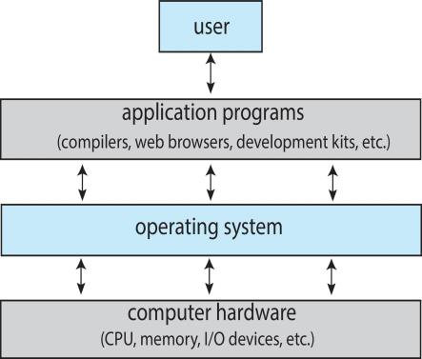
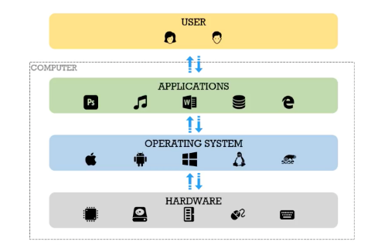
Abstract View of Computer Components

Slide 5
What Operating Systems Do
Depends on the point of view
Users want convenience, ease of use and good performance
Don’t care about resource utilization
But shared computer such as mainframe or minicomputer must keep all users happy
Operating system is a resource allocator and control program making efficient use of Hardware and managing execution of user programs
Users of dedicate systems such as workstations have dedicated resources but frequently use shared resources from servers

Slide 6
What Operating Systems Do (cont’d)
Mobile devices like smartphones and tables are resource poor, optimized for usability and battery life
Mobile user interfaces such as touch screens, voice recognition
Some computers have little or no user interface, such as embedded computers in devices and automobiles
Run primarily without user intervention

Slide 7
Defining Operating Systems
Term OS covers many roles
Because of myriad designs and uses of OSes
Present in toasters through ships, spacecraft, game machines, TVs and industrial control systems
Born when fixed use computers for military became more general purpose and needed resource management and program control
Notes:
*No need

Slide 8
Operating System Definition (cont’d)
No universally accepted definition
“Everything a vendor ships when you order an operating system” is a good approximation
But varies wildly
“The one program running at all times on the computer” is the kernel, part of the operating system
Everything else is either
a system program (ships with the operating system, but not part of the kernel) , or
an application program, all programs not associated with the operating system
Today’s OSes for general purpose and mobile computing also include middleware – a set of software frameworks that provide addition services to application developers such as databases, multimedia, graphics
Notes:
Software/Program that manage HW
Interface to the HW for the user program
Manage HW and ease user

Slide 9
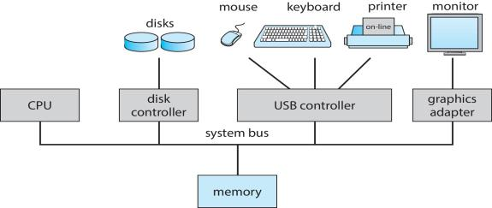
Computer System Organization
Computer-system operation
One or more CPUs, device controllers connect through common bus providing access to shared memory
Concurrent execution of CPUs and devices competing for memory cycles

Slide 10
Computer-System Operation
I/O devices and the CPU can execute concurrently
Each device controller is in charge of a particular device type
Each device controller has a local buffer
Each device controller type has an operating system device driver to manage it
CPU moves data from/to main memory to/from local buffers
I/O is from the device to local buffer of controller
Device controller informs CPU that it has finished its operation by causing an interrupt

Slide 11
Common Functions of Interrupts
Interrupt transfers control to the interrupt service routine generally, through the interrupt vector, which contains the addresses of all the service routines
Interrupt architecture must save the address of the interrupted instruction
A trap or exception is a software-generated interrupt caused either by an error or a user request
An operating system is interrupt driven
Notes:
IVT

Slide 12
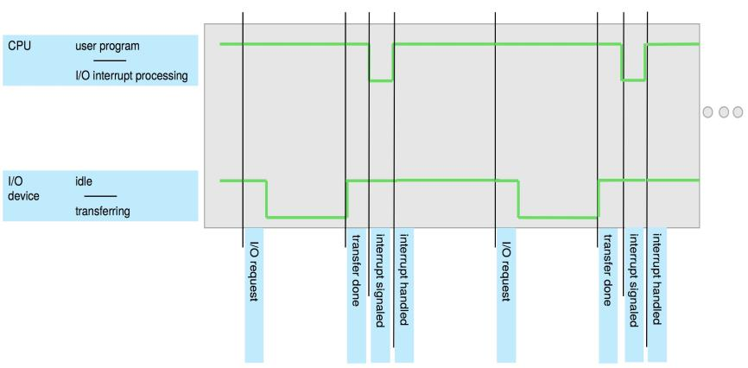
Interrupt Timeline

Slide 13
Computer Startup
bootstrap program is loaded at power-up or reboot
Typically stored in ROM or EPROM, generally known as firmware
Initializes all aspects of system
Loads operating system kernel and starts execution
Notes:
POST
BIOS

Slide 14
Interrupt Handling
The operating system preserves the state of the CPU by storing registers and the program counter
Determines which type of interrupt has occurred:
Polling interrupt (CPU keeps polling at regular intervals if a device is ready)
vectored interrupt (I/O device requests for attention)
Separate segments of code determine what action should be taken (for each type of interrupt)
Notes:
Extra link: https://techdifferences.com/difference-between-interrupt-and-polling-in-os.html
IVT = Interrupt vector table
Interrupt handler

Slide 15
Interrupt-driven I/O Cycle
Notes:
Interrupt vector table …. Store. Interrupt
Interrupt handler ..pick one interrupt and solve..
Hardware/ IO – device controller, device driver, local buffer

Slide 16
Books
Operating Systems Concept
Written by Galvin and Silberschatz
Edition: 9th

Slide 17
References
Operating Systems Concept
Written by Galvin and Silberschatz
Edition: 9th

